Slide 1
Selenium Training

Slide 2
Contents
What is Selenium
Selenium components
Selenium IDE
Selenium Commands
Selenium WebDriver
Element Locators
Xpath
Developer Tools
TestNG
TestNG Annotations
Selenium + TestNG + ReportNG
Maven

Slide 3
Why Automation Testing?
Increase the effectiveness, efficiency and coverage of your software testing.
Improves accuracy and reduces execution time
Reduce maintenance effort and rework.

Slide 4
What is Selenium
Selenium automates browsers.
It is a testing framework for automating web applications.
Selenium scripts run on browsers like IE, Mozilla Firefox, Safari, Opera, Google Chrome, etc., and across operating systems like Microsoft Windows, Linux, Mac, etc.

Slide 5
Selenium components
Selenium IDE
An add-on to Mozilla Firefox
Record and playback tool
Export script to various languages
Selenium Remote Control
Contains two components - Selenium Server and Client libraries
Selenium Server: launches and kills browsers, performs different actions.
Client libraries: interface for different programming languages
Selenium WebDriver (Selenium 2.0)
Selenium 1.0 + WebDriver = Selenium 2.0

Slide 6
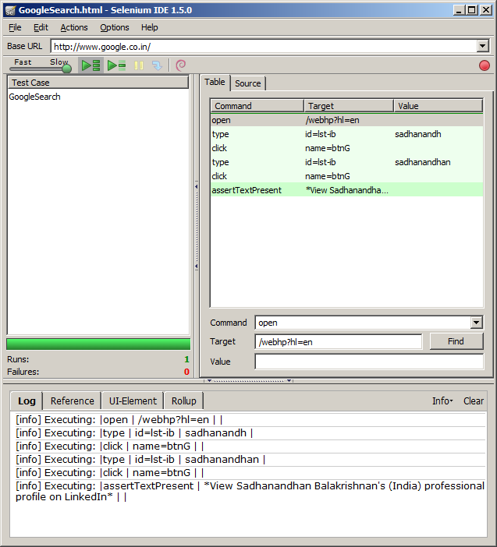
Selenium IDE
The default recorded script is in Selenese, a form of HTML
All the commands are present within the IDE, and easier to code
The field selections or the locators are intelligently selected by the IDE when the scripts are recorded

Slide 7
Selenium Commands
The most common methods:
open(String url)
click(String locator)
type(String locator, String value)
select(String locator, String optionLocator)
check(String locator)
waitForPageToLoad(String timeoutInMilliseconds)
Methods for getting information about a page:
getTitle()
getText(String locator)
getValue(String locator)
isEditable(String locator)
isElementPresent(String locator)
getSelectedLabel(String locator)
getSelectedValue(String locator)
isSomethingSelected(String locator)
isChecked(String locator)
getAlert()

Slide 8
Selenium WebDriver
Selenium-WebDriver makes direct calls to the browser using each browser’s native support for automation
It aims to provide a friendly API that’s easy to explore and understand, which will help to make your tests easier to read and maintain.
It’s not tied to any particular test framework, so it can be used equally well in a unit testing or from a plain old “main” method
WebDriver acts just as any normal library: it is entirely self-contained; we don’t need to remember to start any additional processes or run any installers before using it

Slide 9
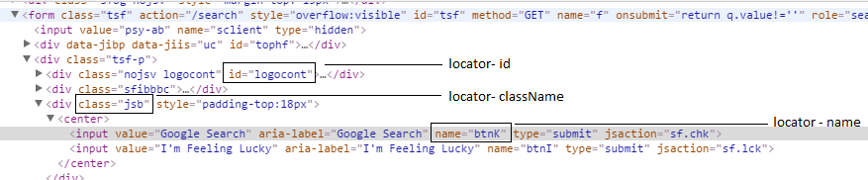
Element Locators
Class Name
cssSelector
Id
Link Text
Name
Tag Name
Xpath

Slide 10
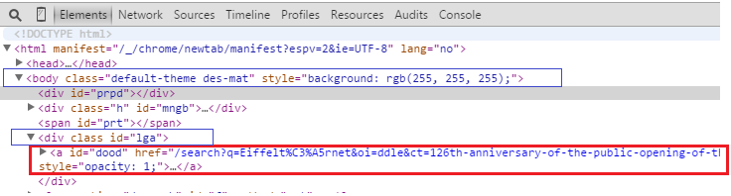
Xpath
In the above html, if we need to identify tag “a”, xpath will be,
Xpath: //a[@id=’dood’]
In the above html, if we need to identify tag “a”, from parent tag <div class id=”lga”>, xpath will be
Xpath: //div[@id=’lga’]/a
In the above html, if we need to identify tag “a”, from parent tag <body>, xpath will be
Xpath: //body/div[3]/a (notice that we have not used attribute with body since its unique)

Slide 11
Developer Tools
Internet Explorer
IE Developer Toolbar
IE 6, 7 - http://www.microsoft.com/download/en/details.aspx?id=18359
IE 8, 9 - Integrated
Mozilla Firefox
Add-ons
Firebug - http://getfirebug.com
Firepath - https://addons.mozilla.org/en-US/firefox/addon/firepath/
Xpath checker - https://addons.mozilla.org/en-us/firefox/addon/xpath-checker/
Xpather – http://xpath.alephzarro.com
Opera
DragonFly - Integrated
Chrome/Safari
Web Inspector - Integrated

Slide 12
Sample WebDriver Test
public class Selenium2Example {
public static void main(String[] args) {
// Create a new instance of the Firefox driver.
WebDriver driver = new FirefoxDriver();
// And now use this to visit Google
driver.get( "http://www.google.com" );
//Find the text input element by its name
WebElement element = driver.findElement(By.name( "q" ));
// Enter something to search for
element.sendKeys( "Cheese!" );
// Now submit the form. WebDriver will find the form for us from the element
element.submit();
// Check the title of the page
System.out.println( "Page title is: " + driver.getTitle());
//Close the browser
driver.quit();
}
}

Slide 13
Part II

Slide 14
TestNG
TestNG is a testing framework written in Java and inspired from JUnit and NUnit.
Results in reliable, maintainable and testable code
The main features are as follows:
Annotations
Test code to be multithread safe
Uses XML to do flexible test configuration
Support for data-driven testing (with @DataProvider)
Supports ignore, time-driven, parameters, test suites, tests and exception tests, etc.

Slide 15
TestNG Annotations
Annotation name | Documentation
@BeforeSuite | The annotated method will be run before all tests in this suite have run.
@BeforeGroups | The Annotated method will run before the first method in any of the specified groups is invoked.
@BeforeClass | The Annotated method will be run before the first method on the current test class is invoked.
@BeforeTest | The Annotated method will be run before any test method in a given is invoked.
@BeforeMethod | The Annotated method will be run before each test method.
@AfterMethod | The Annotated method will be run after each test method.
@AfterTest | The Annotated method will be run after all the test methods in a given have been run.
@AfterClass | The Annotated method that will be run after the last test method on the current class is run.
@AfterGroups | The Annotated method that will be run after the last test method belonging to the groups specified in its value attribute has been invoked.
@AfterSuite | The annotated method will be run after all tests in this suite have run.

Slide 16
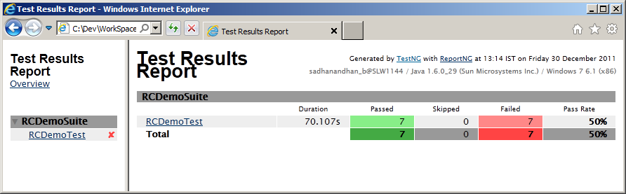
Selenium + TestNG + ReportNG
TestNG as a framework helps with Annotating the test methods
Assertions enabled from within TestNG
ReportNG enables customizable reporting of results

Slide 17
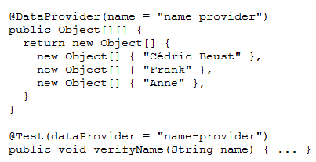
Data Driven Testing
Support for data-driven testing (with @DataProvider)

Slide 18
Example
public class TestNgTest {
WebDriver driver;
@BeforeTest
public void before(){
System.setProperty("webdriver.ie.driver","IEDriverServer.exe");
driver = new InternetExplorerDriver();
driver.get("http://google.com");
}
@Test
public void Test01() {
WebElement textbox = driver.findElement(By.name("q"));
textbox.sendKeys("hello");
}
@AfterTest
public void teminate() {
driver.close();
driver.quit();
}
}

Slide 19
Thank you

